Slide 1
Modeling SAT Scores in CT Districts
Nomi Vilvovsky

Slide 2
Research Question
What factors can be used to determine the percent of students meeting the SAT benchmark?
Do certain factors require attention in order to increase the number of Connecticut students who do well on the SAT?

Slide 3
Defining Our Variables
For proper interpretation, we must first define the explanatory and response variables

Slide 4
SAT Scores
benchmark i j

Slide 5
Explanatory Variables
absent
Percent of students who attend public schools missing more than 15 days of school a year
partic
Percent of students who took the SAT in said district in 2013

Slide 6
Explanatory Variables Cont.
ttchange
Percent increase of students taking the SAT in 2013 compared to 2012
totstudent
Total number of students graduating from public schools in the district
CAPT scores
Math, Writing, Science, and Reading in 2012 (March of sophomore year)

Slide 7
CAPT
State-mandated exam in CT
Math, Writing, Science, Reading
Resampling?
Connection between CAPT and SAT scores?
Recently changed to a different state-mandated exam

Slide 8
County
Random effect?
Different counties have:
Different incomes
Geographic differences
Maybe more?

Slide 9
Note
During the first run of this project, I:
Built 12 models
Performed box cox transformations in R
Used an BIC to compare them
Exponentially transformed estimators to interpret

Slide 10
The essence of strategy is choosing what not to do. —Michael Porter

Slide 11
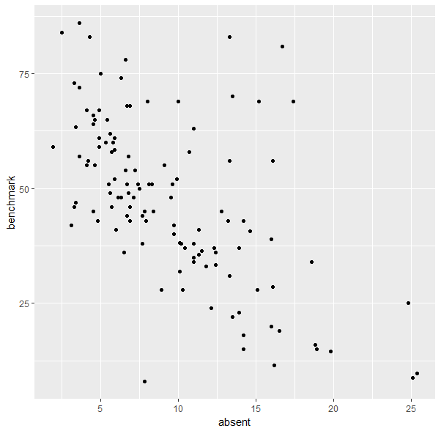
Testing Relationships

Slide 12
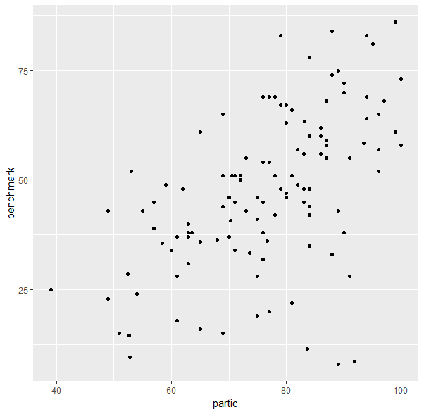
Testing Relationships Cont.

Slide 13
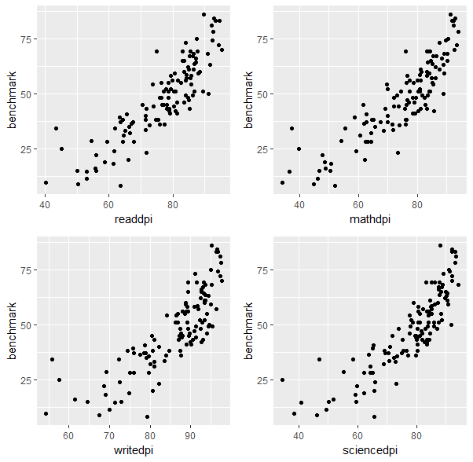
Testing Relationships Cont.

Slide 14
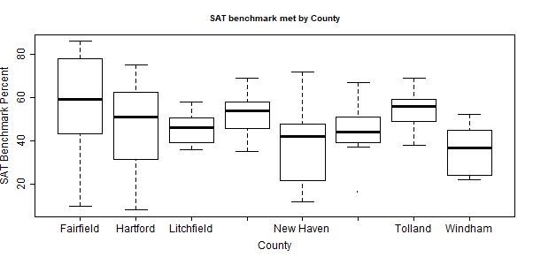
Unequal Variances?

Slide 15
Building Models (interaction)
Model1: partic*absent interaction
With random effect
Model2: ^^ no random effect
Model3: partic*absent interaction +ttchange*partic
With random effect
Model4: ^^ no random effect

Slide 16
Building Models
Model5: no interaction, random effect of county
Model6: ^^ no random effect
ANOVA says Model1 is best
But wait...

Slide 17
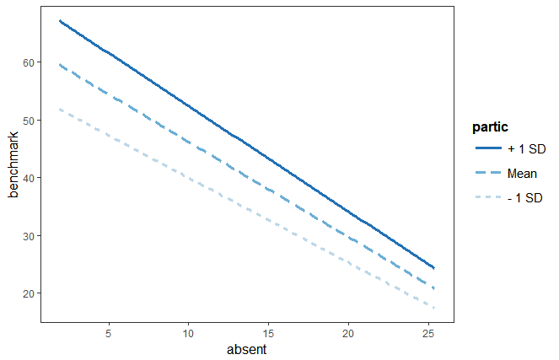
Interaction

Slide 18
New Model
Terms in interaction more important than interact. Term
Test Model9, 10, 11
Model 11 is best
Assumptions:
Shapiro-Wilk Test (normality of residuals)
Mean of residuals close to 0

Slide 19
Results
Derived from estimators of Model11

Slide 20
“Best” Model
percent of students who meet SAT benchmark in district i in county j =-35.2928 + .3742(Absentee percentage in district i) + 0.8959(percent students who pass Reading CAPT in i) + 0.588(percent students who pass Math CAPT in i) - 0.6896(percent students who pass Writing CAPT in i) + .3423(percent students who pass Science CAPT in i) + (1|county j)

Slide 21
Notes about Model
Absent estimator is positive! Why?
Writing CAPT scores estimator is negative! (unlike the other CAPT scores). Why?
Interestingly, before CT completely removed CAPT, they removed writing for a year.

Slide 22
Take-Aways
County effects impact the absentee rate:
Tackle county problems that impact absentee rate rather than actual absences
Standardized tests are not all created equal

Slide 23

THANKS!
Any questions?

